Slide 1
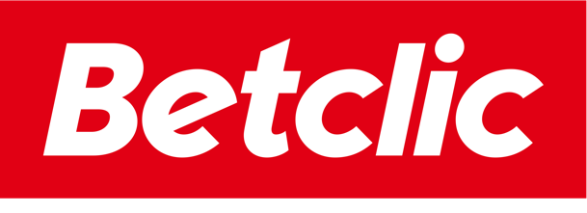
From Vision to Execution: Implementation of Data Mesh at Betclic
May 2025

Slide 2

Speaker
Iouri Shaposhnikov
Chief Data Officer Betclic

Slide 3
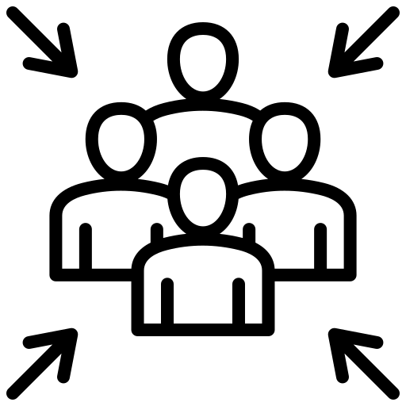


Past Pain Points
Dependency on Centralized Teams
Limited Agility
Data Ownership and Quality
Notes:
Start with a quick description of the state of the art before
Number 1 addressed by move to cloud

Slide 4
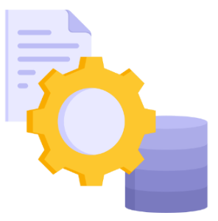
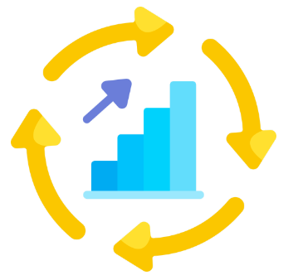

Data Mesh What Is It & Why Did We Decide to implement it?
New Data Platform Architecture introduced by Zhamak Dehghani in 2019
Addresses challenges created by the “centralized data warehouse managed by a single Data team” model and drives significant benefits
But at the same time introduces some challenges of its own …

Slide 5
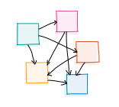
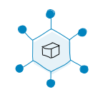
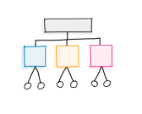
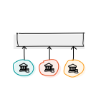
The Four Foundational Principles of Data Mesh
Domain-oriented decentralized data ownership and architecture
Data as a product
Federated computational governance
Self-serve data infrastructure as a platform
Notes:
Data Mesh is a new way of managing data.
It is a concept with a theoretical approach and key ideas, but it should be viewed as a set of principles that can be applied with pragmatism and patience to iteratively build an organization that fits our specific needs.
There is no single path, and the journey is not a straight line.
Datamesh is based on four main pillars:
domain ownership, where each team is in charge of its own data;
data as a product, meaning data is treated like a product to ensure quality;
self-serve data tools, allowing teams to handle their own data;
and federated governance, which makes sure rules are followed across all teams using automation.
We will start by looking at what each principle is, and then see what it could be in real life.

Slide 6




Domain Ownership
Each domain manages its own data end-to-end
THEORY
Domains Own Their Data
Closer to the Source
Decentralized Control
Faster Decision-Making
Improved Data Quality
Stronger Ownership
KEY POINTS
BENEFITS
IN PRACTICE
3 Types of Data Domains:
Source aligned
Aggregated
Consumer-aligned
Data Squads In Domains while still part of a centralised team
What we
did
Notes:
The Principle of Domain Ownership means that the teams (or “domains”) who create or use the data are the ones responsible for managing it.
Instead of having a central team in charge of all the data, each team or domain takes control of its own data.
The key Points of Domain Ownership are:
First, that Teams Own Their Data: Managing its quality, access, and security
But also Accountability: Because with ownership comes responsibility. Teams are accountable for ensuring their data meets quality, security, and standards.
Teams are Closer to the Source: Those who know the data best should manage it.
This promotes decentralised control: ownership of the data is distributed between different domains, rather than being managed by a central team.
And why It’s Beneficial?
Because it brings Faster Decision-Making: each team make quick data decisions without needing central approval.
And it improves Data Quality: When teams own their data, they’re more motivated to keep it accurate and useful since they depend on it for their work.
This requires teams to include a mix of skills, to become cross-functional teams, including data engineering, data science, and domain expertise.
When we talk about responsibilities, we include data collection, data transformation, data storage, data quality and data sharing (access and security).
Data Mesh categorizes domains into three types, but personally, I believe a domain can play multiple roles, so I prefer using these categories when discussing data products.
That being said, the three types are:
source-aligned, like bet history which is close to raw data;
aggregated, like a dashboard consolidating data from different domains to give global insights;
and consumer-aligned, such as a personalized recommendation engine offering product suggestions.
The Domain Ownership principle is one of the core pillars of data mesh. It encourages a decentralized approach to data management.
By decentralizing data management, Data Mesh eliminates bottlenecks and allows teams to respond quickly to changing business needs.
With domain ownership in place, let's now see how data is treated as a product
(
Note : Key responsibilities under domain ownership include:
Data collection: Each domain is responsible for collecting data related to its specific business processes.
Data transformation: The domain ensures that the data is cleaned, transformed, and structured in a way that makes it usable for analysis.
Data storage: The domain selects the appropriate storage solution (models, data lakes) for their data, ensuring it is accessible and secure.
Data sharing: The domain provides its data to other domains in the organization through standardized APIs and interfaces.
Data quality: Each domain is accountable for ensuring the quality, reliability, and accuracy of its data.
)

Slide 7
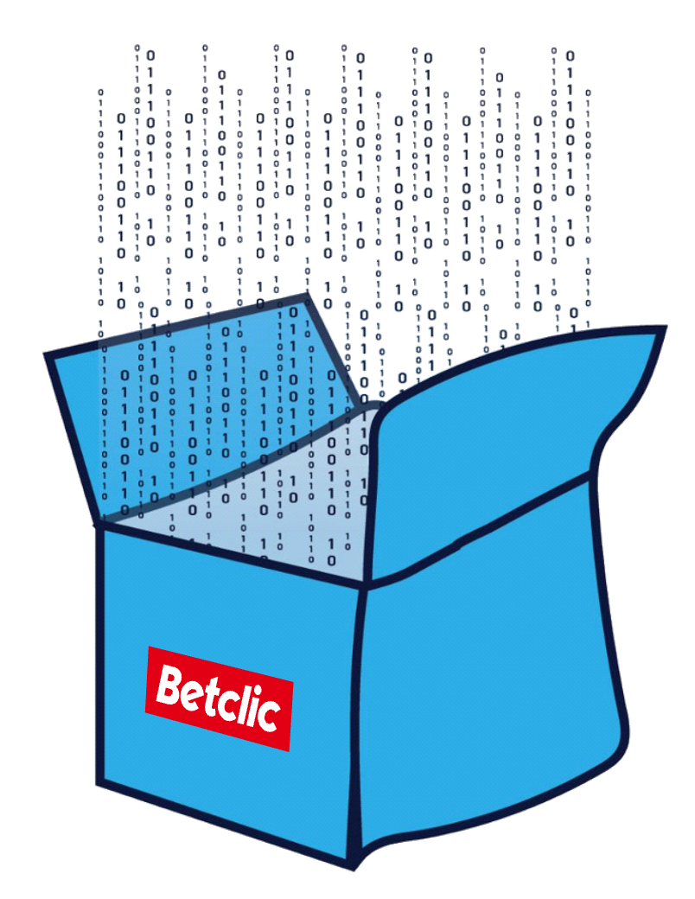
Data As A Product
Data as a Product is about making data user-friendly, reliable, and valuable, just like any other product
THEORY
High-Quality and Reliable
Well-Maintained
Easy to Find and Use
Secure and Private
Better User Experience
More Efficient Collaboration
Higher Value from Data
KEY POINTS
BENEFITS
D iscoverable
A ddressable
T rustworthy
S elf-Describing
I nteroperable
S ecure
The DATSIS acronym
IN PRACTICE
Product Mindset, Data Product Owner roles, Contracts
What we
did

Slide 8
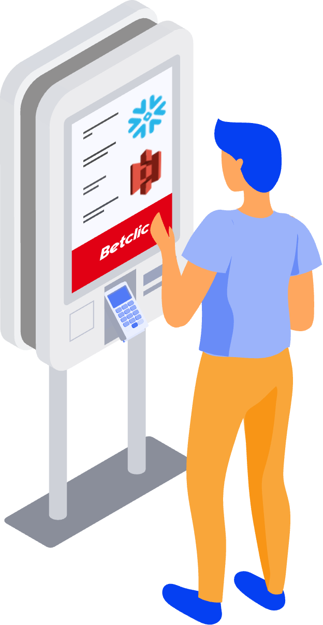
Self-Serve Data Platform
Self-Serve Data Platform aims to provide teams with the tools and autonomy to manage their own data
THEORY
Self-Service and Automated
Scalable and Reliable
Built-In Security and Compliance
Better Quality & Consistency
Stronger Governance
KEY POINTS
BENEFITS
IN PRACTICE
Data Platforms and Data Ops team, Move to Cloud
What we
did

Slide 9
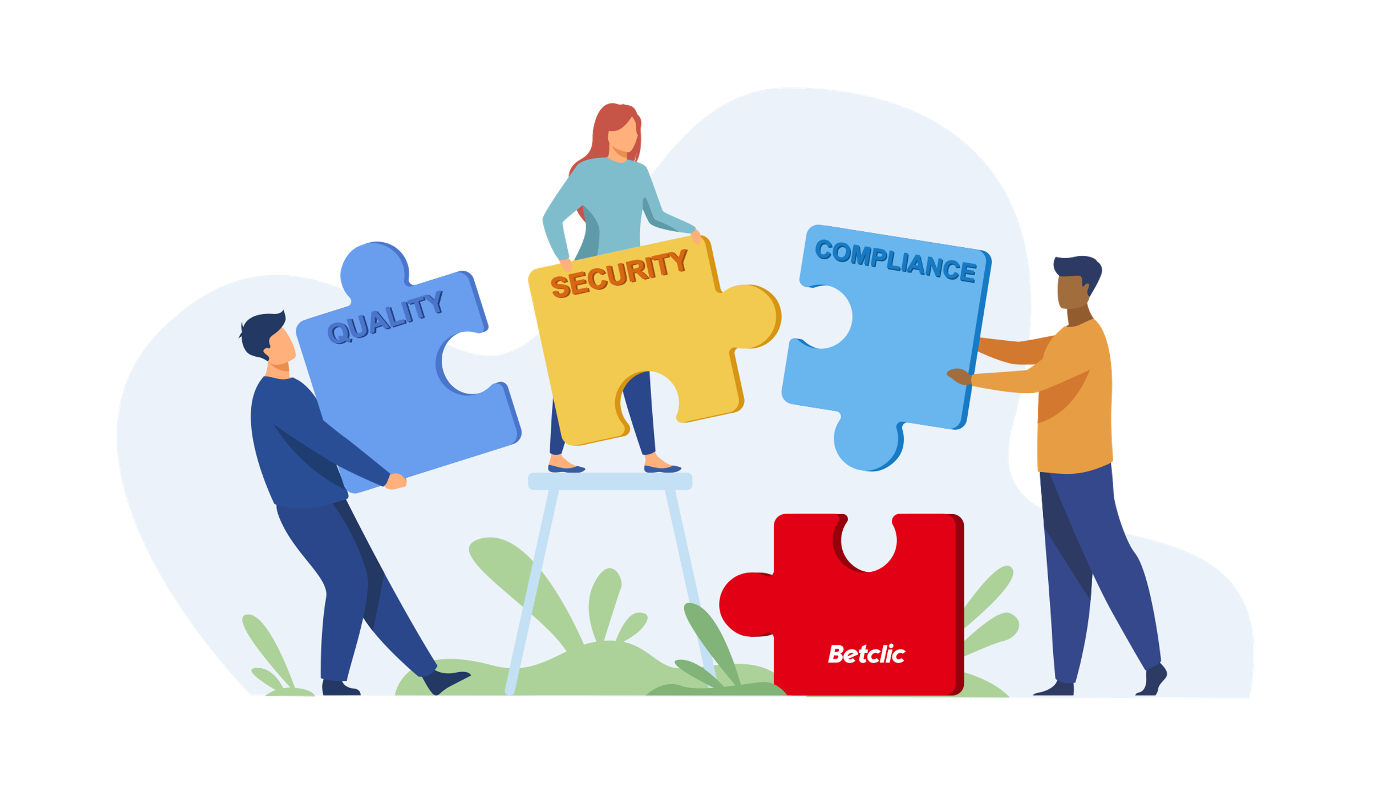
Federated Computational
Governance
Domain-specific autonomy with centralized oversight
THEORY
Decentralized Ownership with central guidelines
Autonomy with Accountability
Standardization Across Domains
Consistency Across the Organization
KEY POINTS
BENEFITS
What is governance?
Maximizing value, minimizing risk
Data Quality Data Security
Data Ownership Access and Sharing
Regulatory Compliance Traceability and Auditability
IN PRACTICE
Security, Compliance and Documentation Policies
What we
did
Notes:
Support developing data products
Enable data discovery
Institute data governance policies

Slide 10
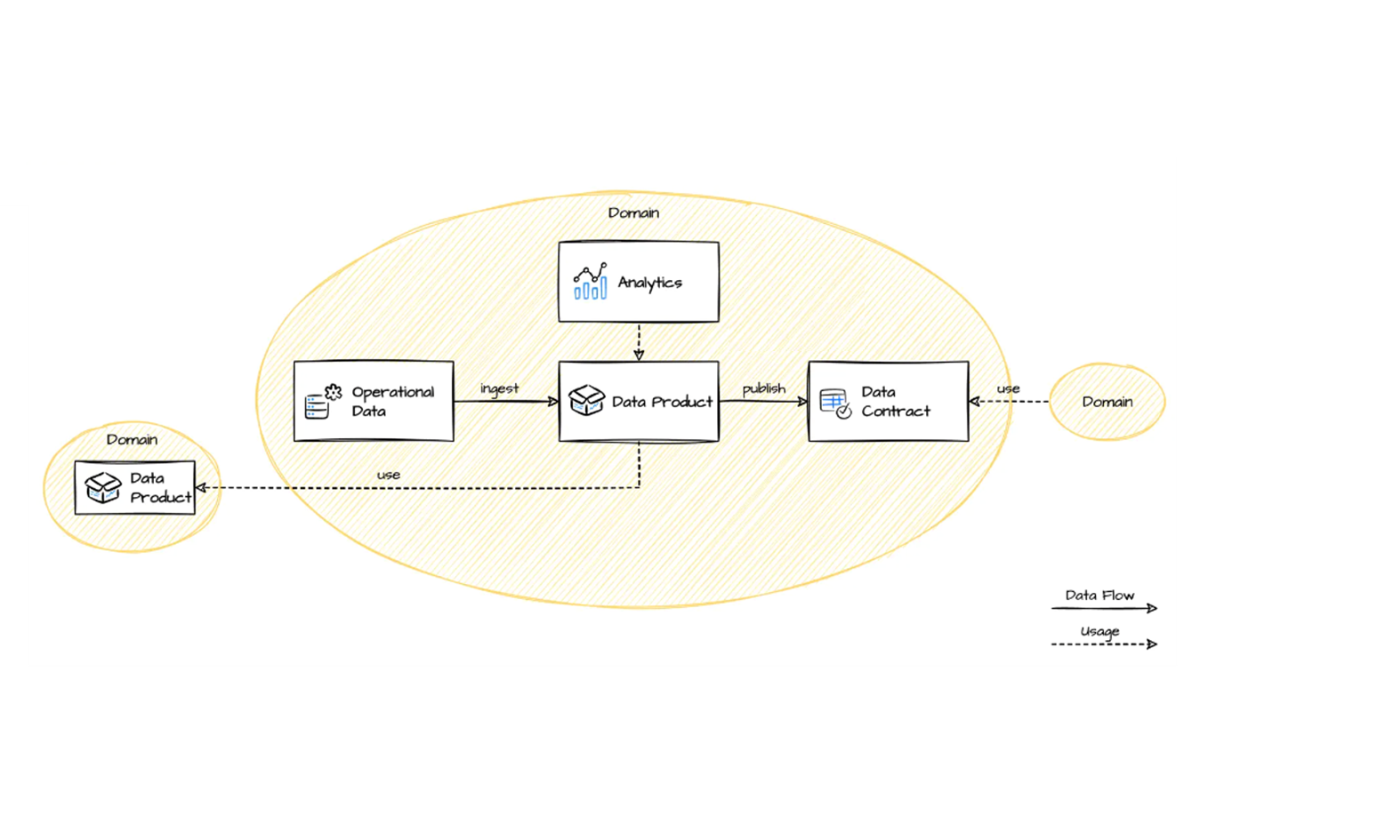
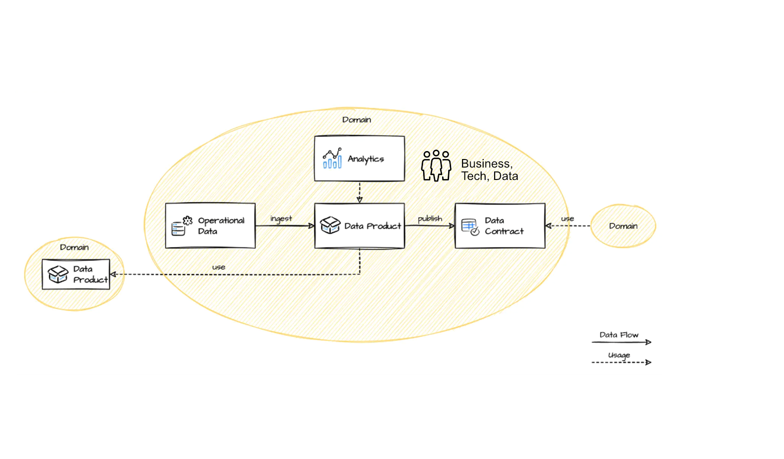
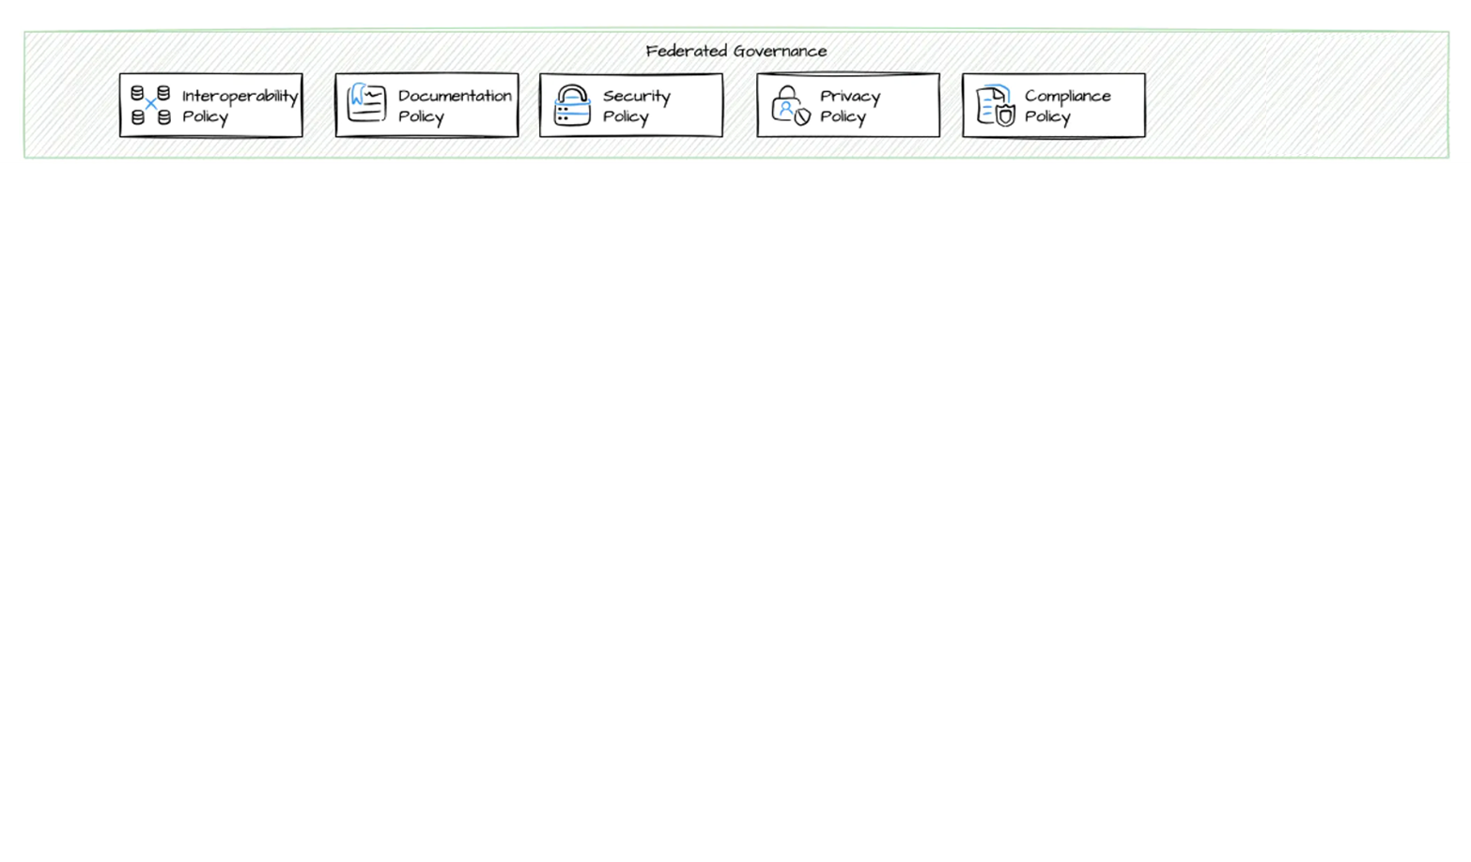
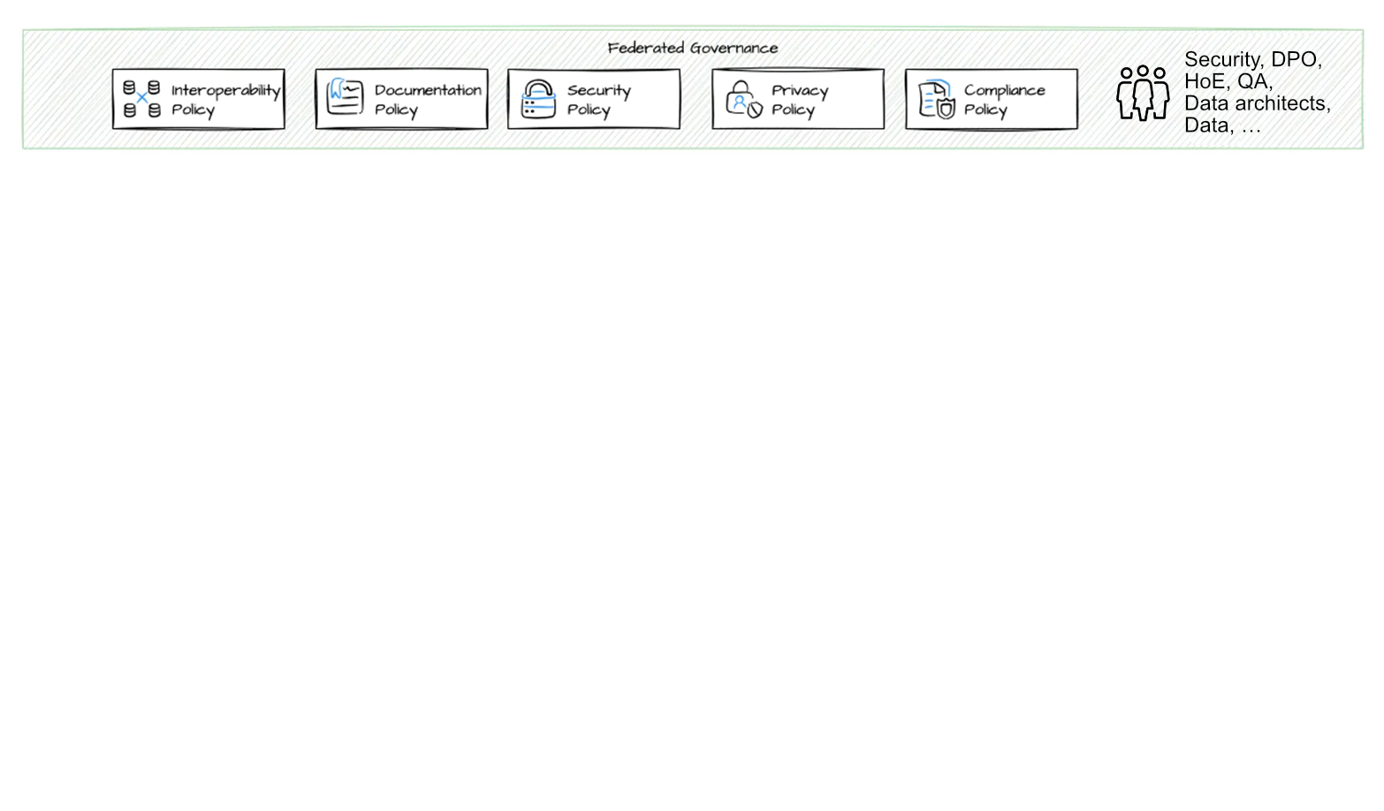
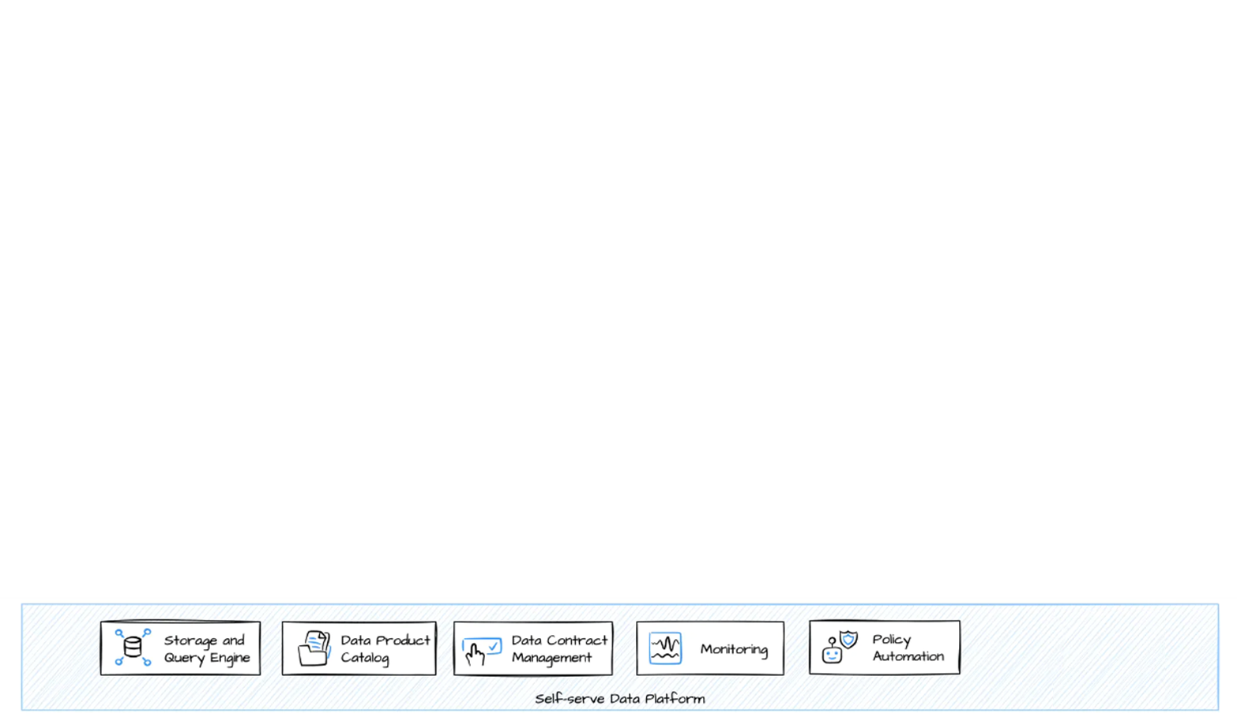
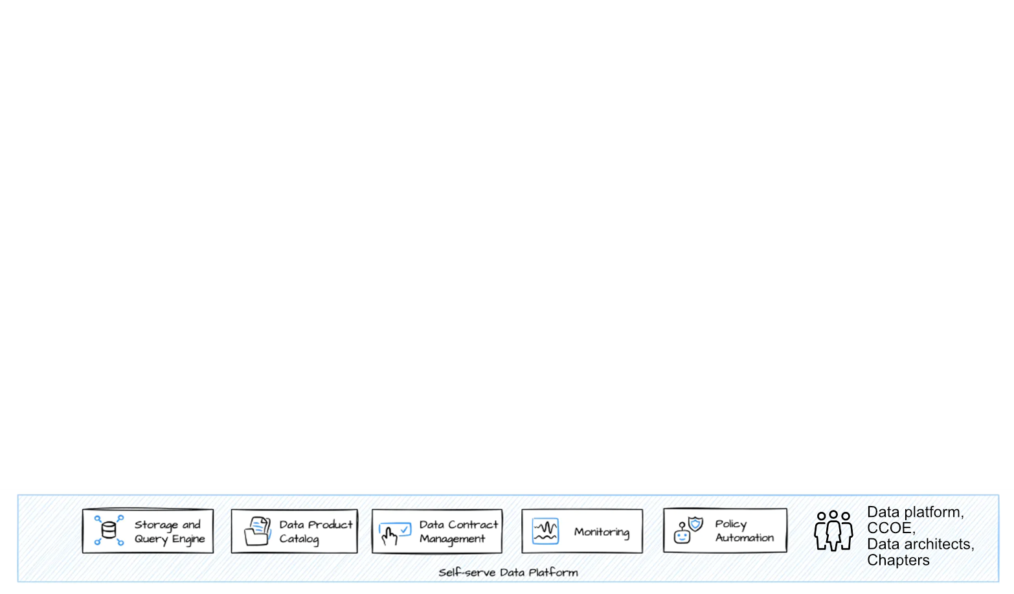
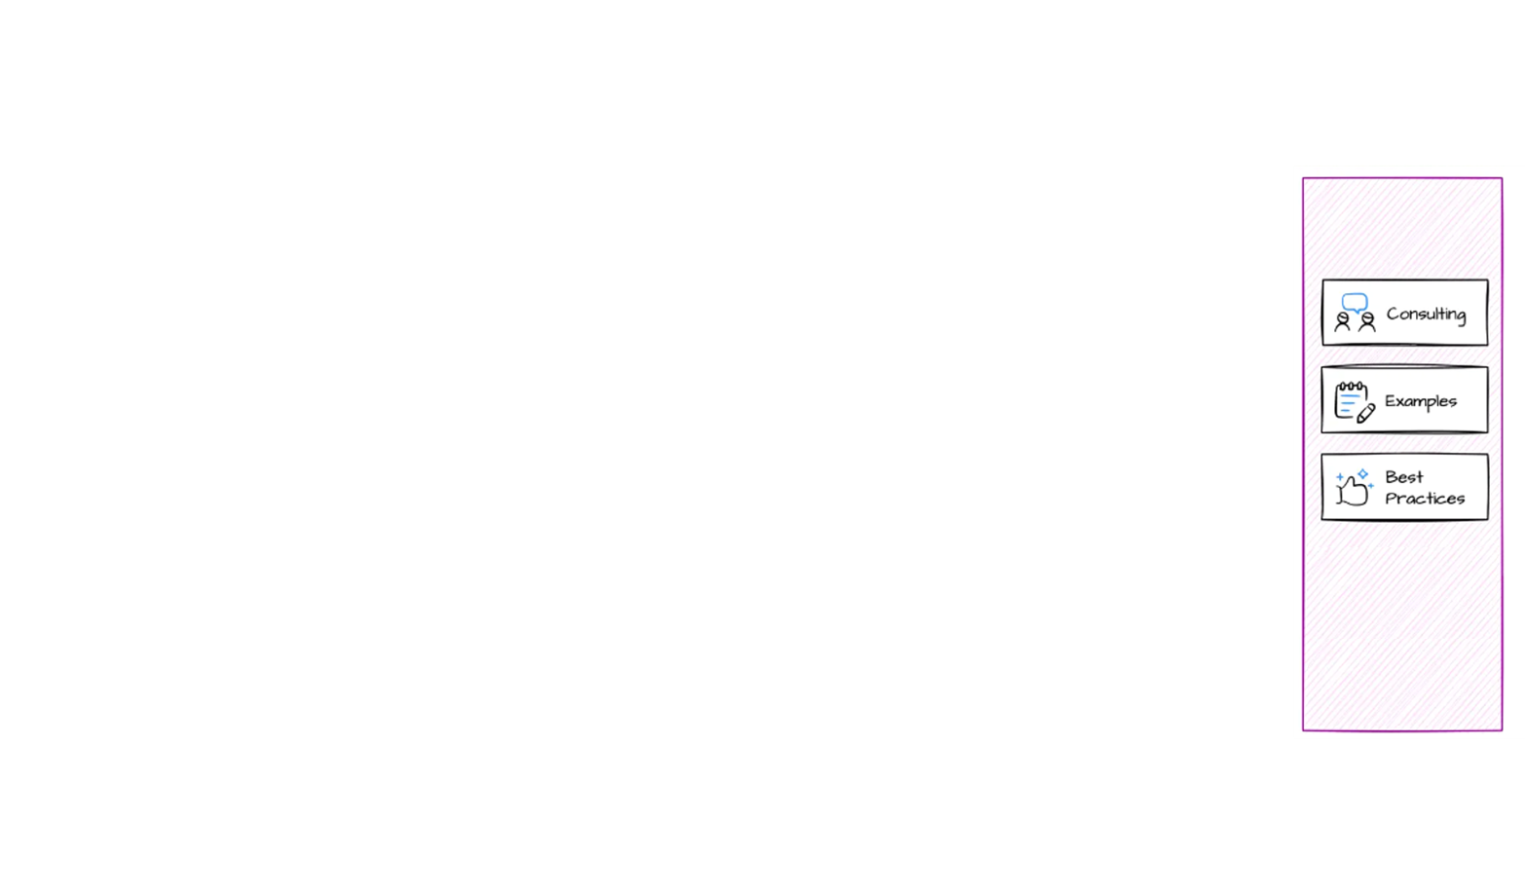
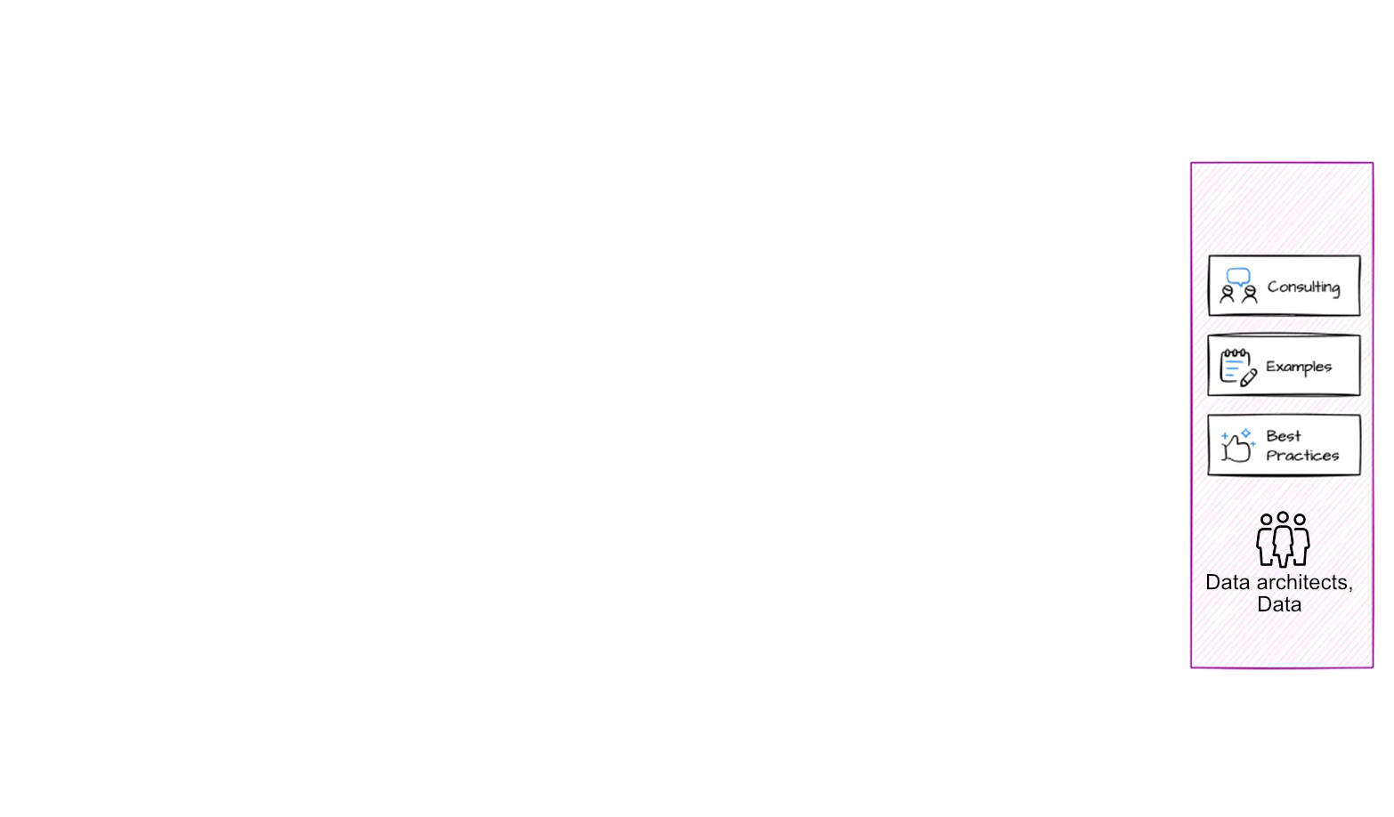
The Datamesh Architecture
Notes:
Let's look at how and with whom the datamesh architecture can be implemented at betclic.
> domain
So we have the domains, most of which manage their operational database.
They are then responsible for ingesting their operational data into their data environment, which today is mostly under Snowflake, and where they build their data products.
These data products can be used as a source for dashboards created by the domain itself, without depending on a central service.
They can also share these data products with other domains, for which they sign a contract with each of their consumers.
The domain is made up of business, tech and data people.
> self-serve data platform
To manage their own data and build their data products, domains will used tools and service provided by the self-serve data platform.
The people involved in building this platform are the data platform team, CCOE, the data architects and all other chapters.
> Federated governance
The domains now have autonomy, but will have to follow the central guidelines provided collegially by a federated governance involving the security team, the DPO, the HOE, Data architects, Data teams, etc.
> Enabling
An enabling team will help other teams to adopt, implement and extend the principles of data meshing. This college is made up of data architects and data members.
Let’s go over the main risks of this transformation and how to avoid them.

Slide 11



But there are still challenges of Data Mesh implementation at Betclic
Cultural Shift is Ongoing
Need better Data Product discovery
Stronger Documentation Policies
Notes:
Cultural Shift -> still many domains that are not really trully fully owners of their data
Enable data discovery -> we are not yet good enough on data discovery part and could do better on data cataloguing

Slide 12

Future of Data Mesh at Betclic

Slide 13
Questions?
Notes:
Explanation of the data product dev cycle.

Slide 14


>Appendix
Betclic at a glance
+25%
2.5M
Revenue GR (‘22-’23)
4
# of Active Customers​
# of Top 3 Market Positions
0.1%
# of Customer at risk
1,050
85%
# of People
# of Employee satisfaction
77%
# of CS satisfaction​

Slide 15
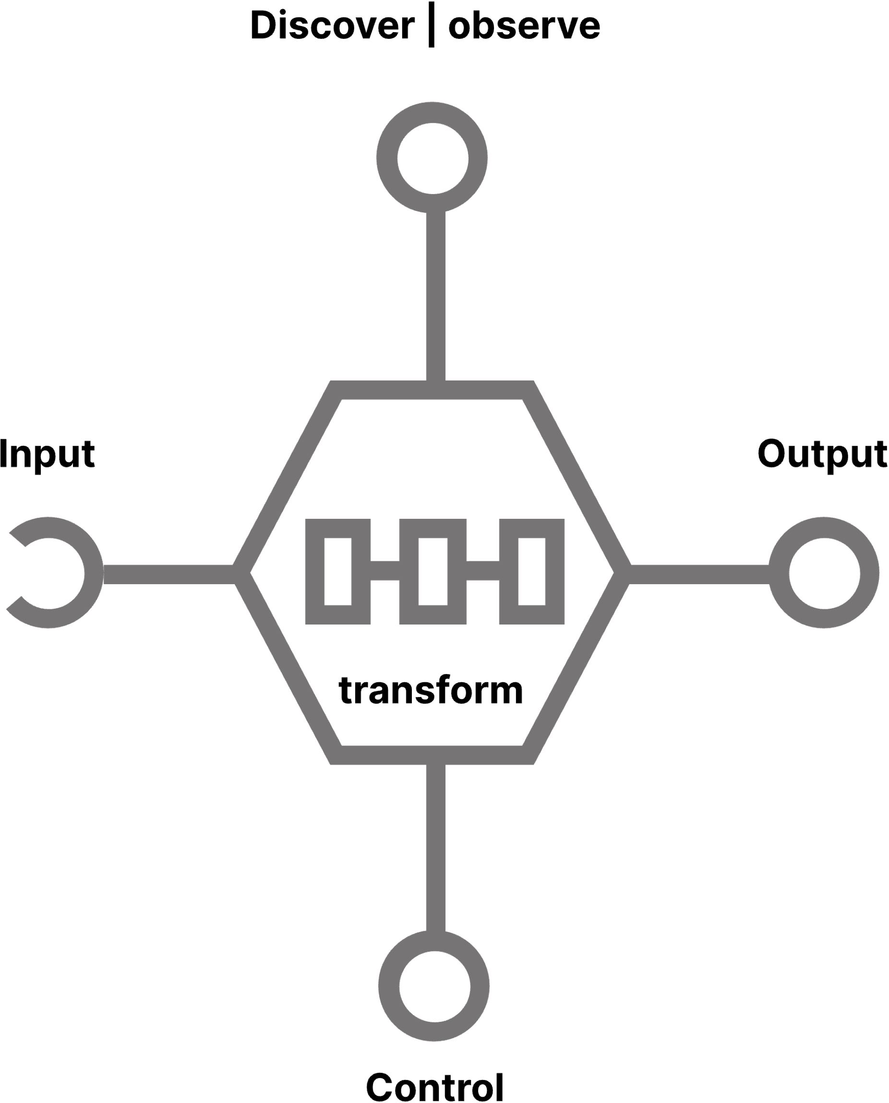
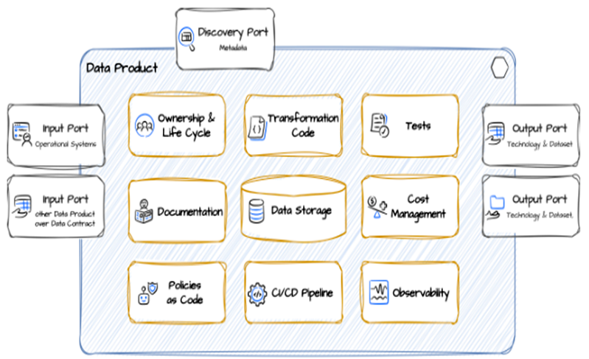



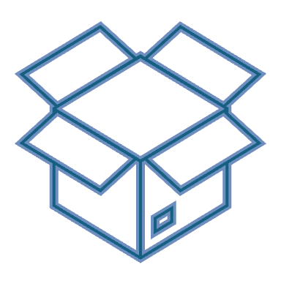
Focus On A Data Product
Data product unit
Consumers
Person
CONTRACT
Team
At Betclic
No access to internal tables allowed, only shared Snowflake views, or other APIs
Data contracts are now available and mandatory
Data product
a data product unit in Data Mesh is like a microservice but for data
1 piece of code (1 repository)
Notes:
For the technical audience, let's focus on what a data product unit is.
A data product can take the form of a dashboard or a machine learning model, but at its core, it always starts with foundational data products that generate and structure the data, which in turn serves as the basis for these end products.
If I had to make an analogy for software developers, a data product unit in Data Mesh is like a microservice but for data.
It must include the owner, documentation, pipelines, storage creation, unit tests, monitoring, and more to ensure full autonomy and reliability.
It can scale independently.
To share data, this unit exposes APIs, which, in our case, are mostly Snowflake views. No access ton internal tables are allowed.
To use these APIs, both the producer and consumer must follow a data contract, ensuring clear rules and expectations around how the data is accessed, shared, and used.
This contract applies regardless of the type of consumer, whether it is an individual, a team or another data product.

Slide 16
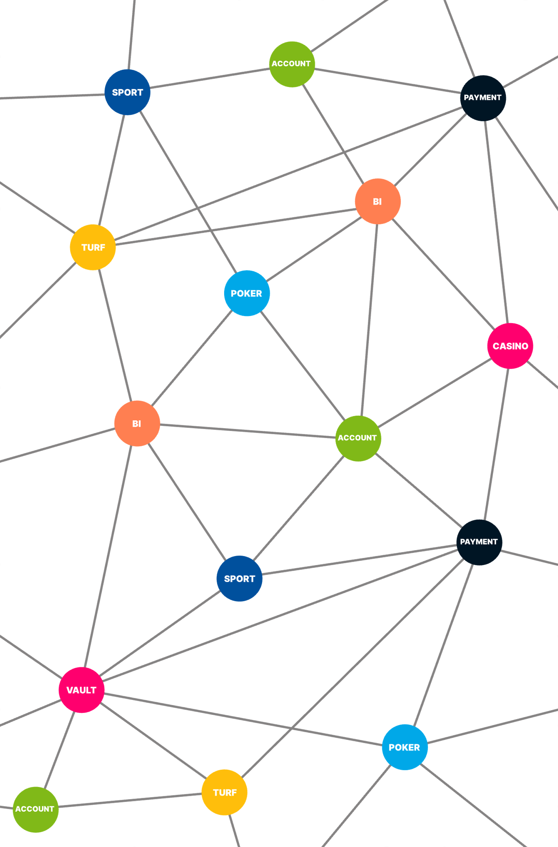
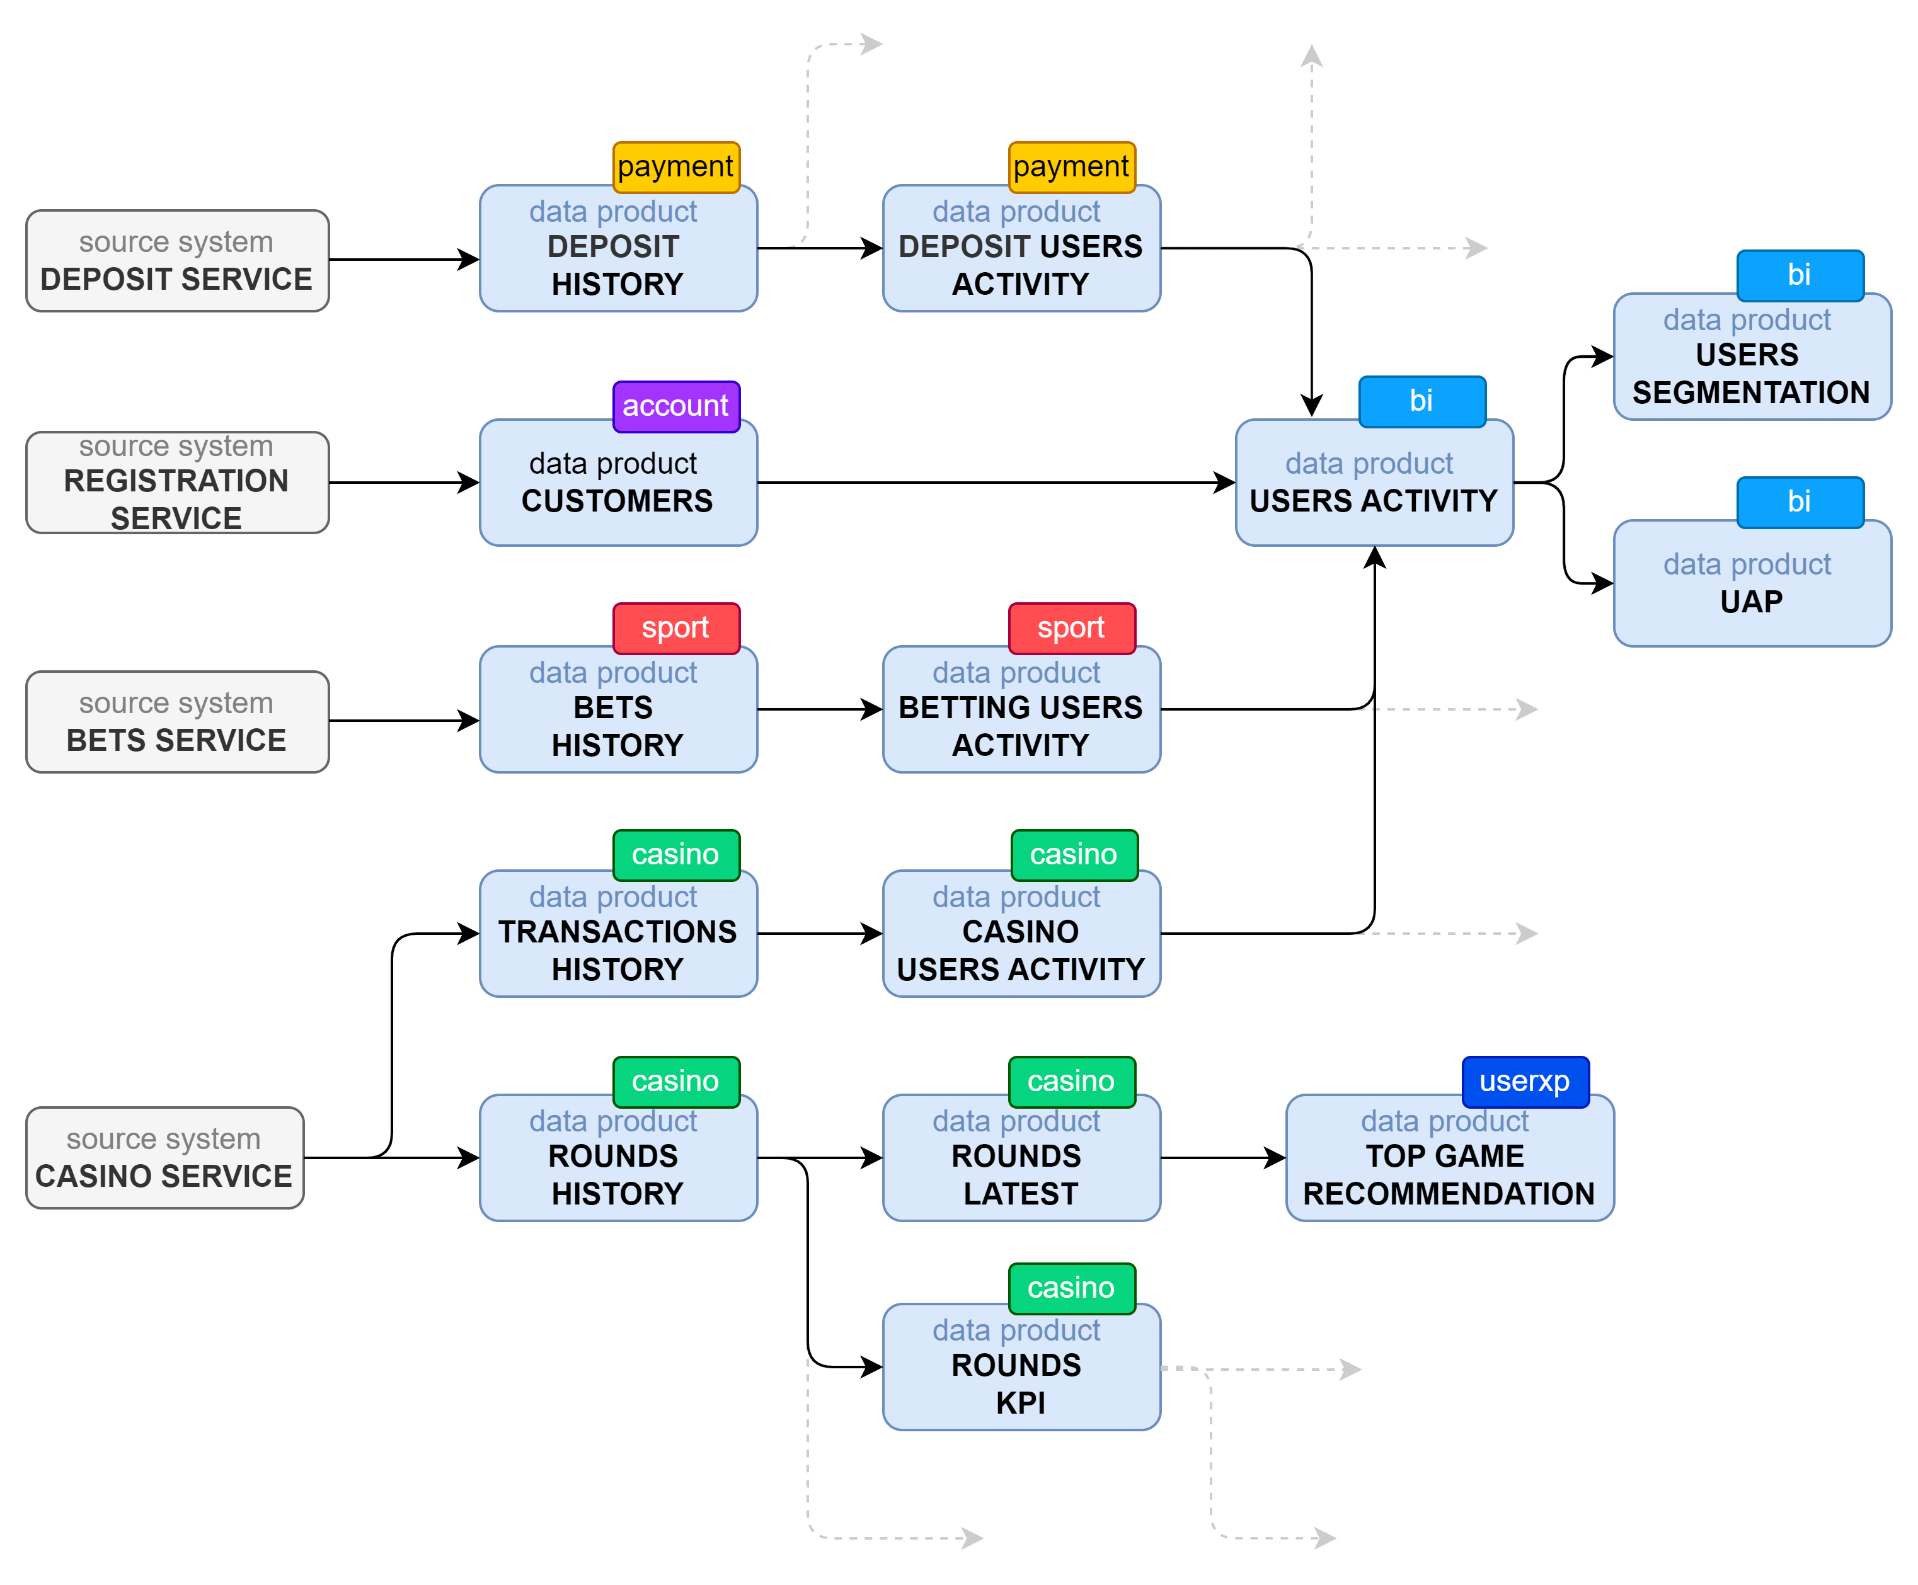
Data Product Meshing
Notes:
So, what can we do now that we have many data products?
We perform data product meshing, which involves connecting and integrating these individual products to create a unified, interconnected data ecosystem for better insights and collaboration.
Data product meshing is simply a network of individually simple, easily modifiable data products that come together to form a whole.
Data Product Meshing makes data lineage easy to track, showing where data comes from and how it moves between products.
This also helps clearly define and manage costs shared between data products.
But if we want all this to work, we need to know what data product exists, or doesn't exist.
So they need to be published in a central catalog.

